Slide 1

Health Insurance Prediction using Machine Learning
Soham Shedale 537
Rudra Singh 540
Chirag Suryawanshi 543
Uttkarsh Wadgave 545

Slide 2

Introduction
Health insurance plays a crucial role in ensuring access to healthcare services, and predictive analytics using machine learning can enhance its efficiency and effectiveness.
Machine Learning (ML) automates and improves insurance cost predictions.
Machine Learning models learn from past insurance data to predict costs.
Our main aim is to enhance methods for estimating insurance costs.

Slide 3

Literature Review
Rama Devi Burri, Ram Burri, Ramesh Reddy Bojja, Srinivasa Rao Buruga (2019)
Explored Machine Learning for Insurance Claim Prediction
In this paper, they survey the state-of-the-art machine learning (ML) for insurance claim prediction. ML has had a significant impact on insurance claim prediction, with ML-powered systems now being used to predict the likelihood of a customer filing a claim, the severity of a claim, and the type of claim with high accuracy. However, there are still challenges that need to be addressed before ML can be more widely adopted for insurance claim prediction, such as the need for high-quality training data, the need to develop ML models that are robust to noise and ambiguity in the data, and the need to ensure that ML models are fair and unbiased. Despite the challenges, they concluded that ML has the potential to revolutionize the insurance industry by helping insurers reduce costs and provide better service to their customers.

Slide 4

Objective and Need for Predicting Health Insurance
Objective:
The goal of this project is to give an estimate of how much they need on their individual health situation and Build a solution that should able to predict the premium of the personal for health insurance.
Need:
Budgeting and Financial Planning
Policy Planning and Decision-Making
Fraud Detection and Prevention

Slide 5
Technologies Used
Python:
Python plays a pivotal role in our health insurance cost prediction system, serving as the primary programming language that enables data analysis, machine learning, and web-based user interface development.
HTML, CSS, and JavaScript:
HTML, CSS, and JavaScript collectively contribute to the development of an interactive and user-friendly user interface for our health insurance cost prediction system.
Libraries Imported
Our health insurance cost prediction system leverages a range of libraries and frameworks to accomplish various tasks, from data processing to machine learning and web development.
Scikit-learn
Pandas
NumPy

Slide 6
Model Development
1
Algorithm Selection
Here, We experimented with various machine learning algorithms
We compared the performance of different models to identify the most accurate and reliable prediction model.
2
Model Comparison
3
Model Training & Testing
We trained our selected algorithm using the training dataset and fine-tuned its hyperparameters to optimize performance.
We evaluated the model using various performance metrics, such as accuracy, precision, recall, and F1 score.
4
Evaluation

Slide 7
Data Collection
We utilized a dataset from Kaggle for creating our prediction model.
This dataset comprises seven attributes and is divided into two parts: training data and testing data.
To train the model, 80% of the total data was used, while the remaining 20% was designated for testing.
Age | Age of client
Sex | Male/Female
BMI | Body Mass Index
Children | Number of children/kids the client has
Smoker | Whether a client is a smoker or not
Region | Whether the client lives in southwest, northwest, southeast or northeast
Charges | Medical Cost the client pay

Slide 8

Algorithm Selection
For algorithm selection, we measured the accuracy of the following models:
Linear Regression
Random Forest
SVR
Gradient Boosting
Here, we selected the Gradient Boosting Algorithm.

Slide 9
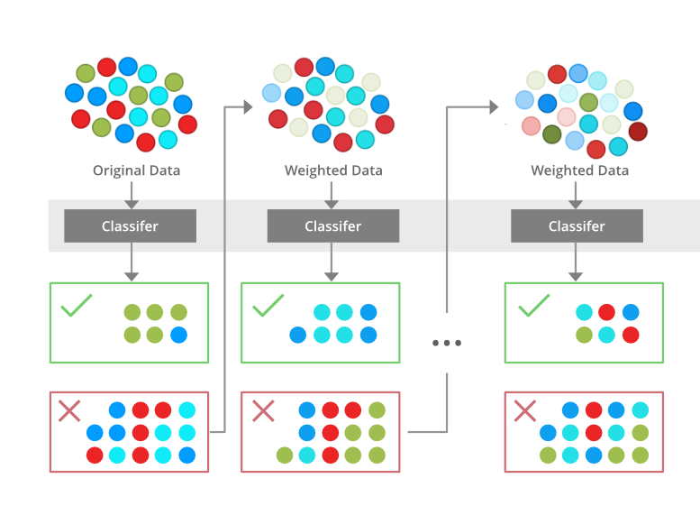
What is Gradient Boosting?
Gradient boosting is an ensemble machine learning technique that combines multiple weak learners (decision trees) to create a strong predictive model.
It iteratively improves the model by learning from the mistakes of previous iterations, leading to enhanced accuracy.
Gradient boosting is particularly well-suited for complex and nonlinear relationships in data, making it a suitable choice for health insurance prediction.

Slide 10
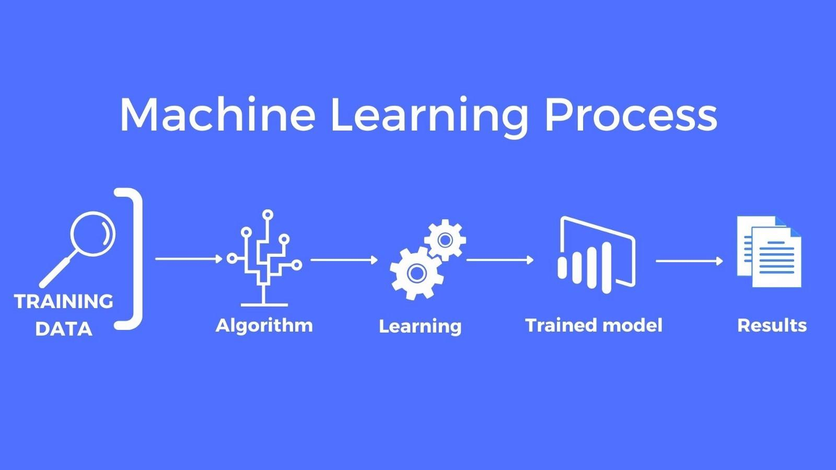
Model Training
Model training is the process of optimizing a machine learning model's parameters to improve its performance on a specific task. The goal of model training is to find the best set of parameters that allow the model to make accurate predictions or classifications based on the provided data.
To train the model, 80% of the total data was used.
The gradient boosting algorithm achieved an impressive accuracy of 84% in predicting health insurance costs.
This high accuracy demonstrates the effectiveness of the model in capturing the underlying patterns and relationships in the data.

Slide 11

Model Testing
Model testing is a crucial step in the development and deployment of machine learning models. It involves evaluating the performance of a trained model on unseen data to assess its generalizability and robustness.
The goal of model testing is to ensure that the model can make accurate predictions on new data, not just the data it was trained on.
We designated 20% of the data for testing.

Slide 12
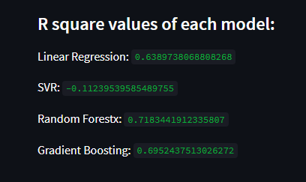
Model Evaluation

Slide 13
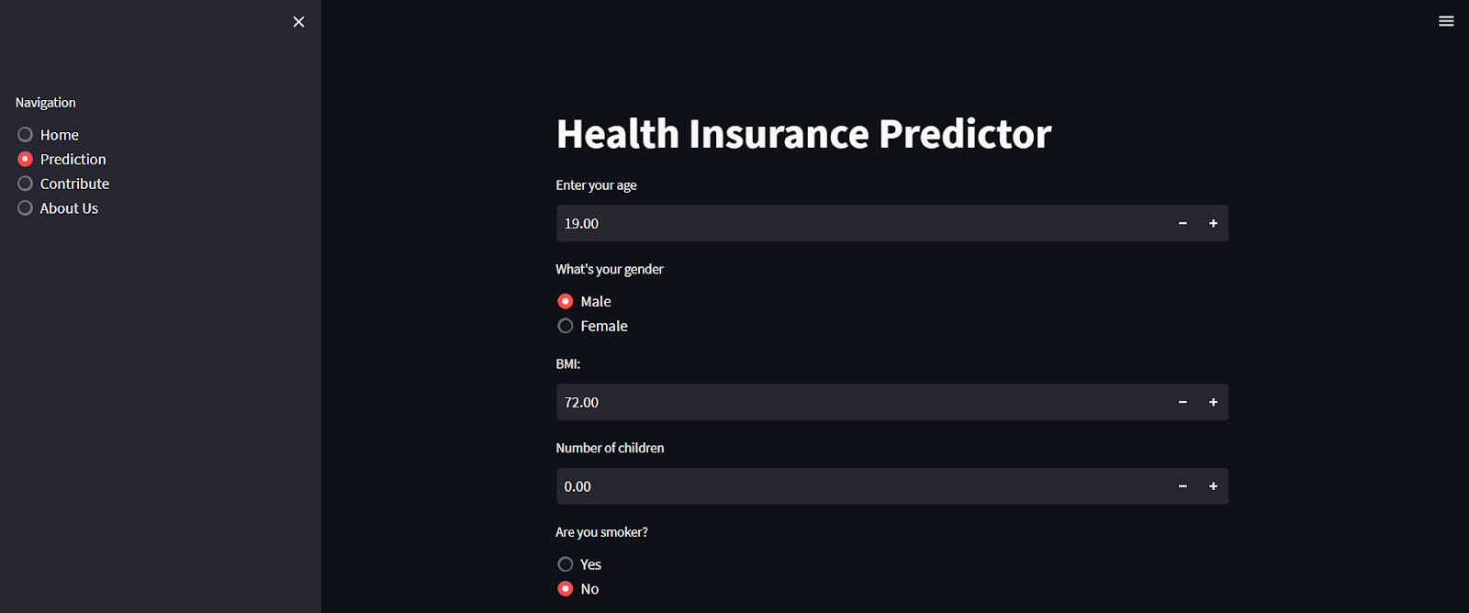

Project Screenshot

Slide 14

Conclusion and Future Scope
1
Conclusion
In conclusion, our health insurance cost prediction project has not only met but exceeded its objectives, providing a valuable resource for users and insurance providers alike.
Our system's predictions have proven to be highly accurate and reliable, demonstrating the potential to benefit both individual users and insurance companies.
2
Future Scope
Looking ahead, the future scope of our health insurance cost prediction system holds exciting potential.
We anticipate further refining our model's accuracy and expanding its capabilities.
Additionally, the development of mobile applications and integration with wearable health devices is promising.

Slide 15
References
[1] A. Ravishankar Rao, Subrata Gardaí, Coumarate Dey, Hang Peng, “Building predictive models of healthcare costs with open healthcare data”,2020 IEEE International Conference on Healthcare Informatics (ICHI) | 978-1-7281-5382- 7/20/$31.00 ©2020 IEEE | DOI: 10.1109/ICHI48887.2020.9374348
[2] Pei Shen, “Factor Analysis of Medical Expenses of the Hepatitis A patients in Guangdong”, 2016 8th International Conference on Information Technology in Medicine and Education.
[3] Ker-Tahj Shantung-Ming Yan and Pei-Wen Liu, “A Study on the Annualized Medical Expense Prediction Model of the Bureau of National Health Insurance --The Application of the Grey Prediction Theory”, 2006 IEEE International Conference on Systems, Man, and Cybernetics October 8-11, 2006, Taipei, Taiwan.
[4] Sheng Yao Zhou, Run tong Zhang*, “A Novel Method for Mining Abnormal Expenses in Social Medical Insurance” Auckland University of Technology. Downloaded on November 07,2020 at 17:01:50 UTC from IEEE Xplore.
[5] Li Cheng, Sino Jalin Pan, “Semi-supervised Domain Adaptation on Manifolds”, IEEE TRANSACTIONS ON NEURAL NETWORKS AND LEARNING SYSTEMS, VOL. 25, NO. 12, DECEMBER 2014.
[6] Yang Xia, Gunter Schreier, David C.W. Chang, Sandra Neubauer, Ying Liu, Stephen J. Redmond, Nigel H. Lovell,” Predicting Days in Hospital Using Health Insurance Claims”, IEEE Journal of Biomedical and Health Informatics - DOI :10.1109/JBHI.2015.2402692.
[7] Shruti Kaushik, Abhinav Choudhury, Sayed Natarajan, Larry A. Pickett, Varun Dutti,” Medicine Expenditure Prediction via a Variance Based Generative Adversarial Network”, 2018 IEEE International Conference volume.
[8] Anuja Tike, Sanket Tavarageri,”A Medical Price Prediction System using Hierarchical Decision Trees”,2017 IEEE International Conference on Big Data.

